Slide 1
Sharing Resources
Lesson 6

Slide 2
Objectives
Manage NTFS and share permissions
Determine effective permissions
Configure Windows printing
Notes:
Outline the material you are going to cover in this lesson. Do not go into detail as each of these points will be expanded on in the lesson. You may also want to mention the Technology Skills that are being covered for the Certification exam also.

Slide 3
Permissions
Privileges granted to specific system entities, such as
  Users
  Groups
  Computers
Enabling the entities to perform a task or access a resource
Example - you can grant as pecific user permission to read a file, while denying that same user the permissions needed to modify or delete the file
Notes:
Discuss the concept of permissions in general. Talk about the different system entities that need to be secured with permissions. Briefly describe each type of permission on the slide.

Slide 4
Managing Permissions
NTFS permissions - Control access to the files and folders stored on disk volumes formatted with the NTFS file system
Share permissions - Control access to files and folders shared over a network
Registry permissions - Control access to specific parts of the Windows registry
Active Directory permissions - Control access to specific parts of an Active Directory hierarchy
Notes:
Discuss the concept of permissions in general. Talk about the different system entities that need to be secured with permissions. Briefly describe each type of permission on the slide.

Slide 5
Windows Permission Architecture
Access Control List (ACL)
Access Control Entries (ACEs)
Security principal
Permission
ACL
Sales – Read
Managers – Full Control
JSmith – Deny Access
ACL
Sales – Read
Managers – Full Control
JSmith – Deny Access
Folder
ACEs
Security Principal
Notes:
Describe each element of the Windows Permission Architecture.

Slide 6
Windows Permission Architecture
It is crucial to understand that, in all of the Windows operating systems, permissions are stored as part of the element being protected, not the security principal (user or Group) being granted access.
when you grant a user the NTFS permissions needed to access a file, the ACE you creare is stored in the file's ACL; it is not part of the user account. You can move the file to a different location, and its permissions go with it.

Slide 7
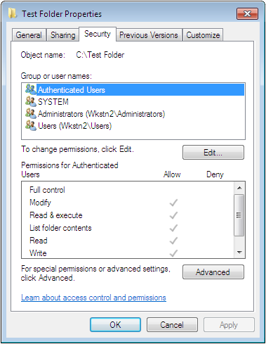
The Security Tab
element being
protected
security principals
permissions
Notes:
Use the screen shot on the slide to show the Security Principals and the permissions.

Slide 8
Standard and Special Permissions
Permissions allow you to grant specific degrees of access to security principals (granular).
Preconfigured permission combinations are called Standard Permissions.
Special Permissions are more granular and can be applied individually, but are rarely used.
Notes:
Describe Standard and Special Permissions. Use the previous slide to show the Standard Permissions and the next slide to show where you would set Special Permissions.

Slide 9
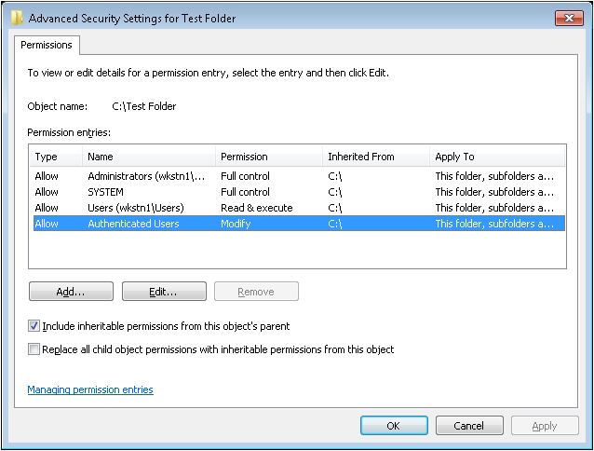
Advanced Security Settings Dialog Box

Slide 10
Allowing and Denying Permissions
Additive
  Start with no permissions and then grant Allow permissions (preferred method)
Subtractive
  Start by granting Allow permissions and then grant Deny permissions
Notes:
Describe the different methods that can be used to apply permissions to a system element.

Slide 11
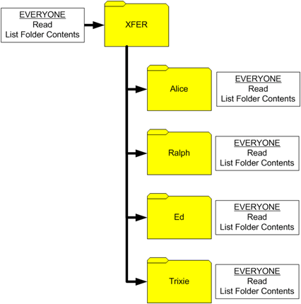
Inheriting Permissions
The most important principle in permission management is that permissions tend to run downward through a hierarchy.
This is called permission inheritance

Slide 12
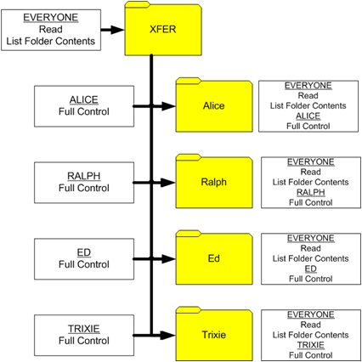
Inheriting Permissions
Now the administrator assigns each user the Allow Full Control permission
By doing this the administrator does not compromising the security of the other users‘ folders

Slide 13
Preventing Permission Inheritance
There are two ways to prevent subordinate elements from inheriting permissions from their parents.
  Turn off inheritance: V{hen you assign special permissions, you can configure an ACE not to pass its permissions down to its subordinate elements. This effectively blocks the inheritance process
  Deny permissions: -When you assign a Deny permission to a system element, it overrides any Allow permissions that the element might have inherited from its parent objects.

Slide 14
Copying and Moving NTFS FIles
Copy file to a folder within NTFS volume, inherits folder permissions
Copy file to a folder between NTFS volumes, inherits folder permissions
Move file to a folder between NTFS volumes, inherits folder permissions
Move file to a folder within NTFS volume, retain permissions regardless what permissions the folder may have
Copy or move file from FAT32 to NTFS volume, inherits folder permissions
Notes:
Describe what happens when you Move or Copy a file to a folder on the same NTFS volume or to a different NTFS volume.

Slide 15
Effective Permissions
The combination of Allow permissions and Deny permissions for each security principal:
  Allow permissions are cumulative.
  Deny permissions override Allow permissions.
  Explicit permissions take precedence over inherited permissions.
Notes:
Discuss Effective Permissions. It is helpful to go over several examples to show students how the permissions work.

Slide 16
Allow Permissions
When a security principal receives Allow permissions from more than one source, the permissions are combined to form effective permissions.
One of the primary principle use in permissions is that they are assigned to groups not users.
Deny permission overrides allow permissions

Slide 17
Folder (element)
Security Principals
Accountants permissions
Read - allow
Write - allow
Administrator
Modify - allow
Fred is a member of both the Accountants and Administrators group
What are Fred’s effective permissions?

Slide 18
Folder (element)
Security Principals
Accountants permissions
Read -allow
Write – allow
Modify - allow
Administrator
Read -allow
Write – allow
Modify - deny
Fred is a member of both the Accountants and Administrators
What are Fred’s effective permissions?

Slide 19
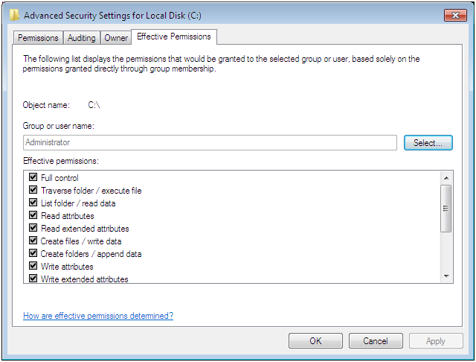
Effective Permissions Tab
Notes:
Explain how to use this tab.

Slide 20
Managing NTFS Permissions
What can Jsmith do with this folder?
Security Descriptor
Folder – Secured Object
ACL
Sales – Read
Managers – Full Control
JSmith – Deny Access
Access Token
Jsmith
Groups:
Sales
SID
When you log on using your user ID and password you receive the Access Token
The Access Token is compared with the ACE’s in the ACL to determine what you can do with the resource
Notes:
Explain SIDs and Access Tokens and what happens when a user logs on and then accesses a secured resource.

Slide 21
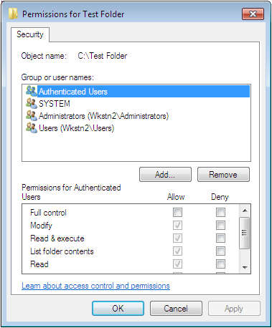
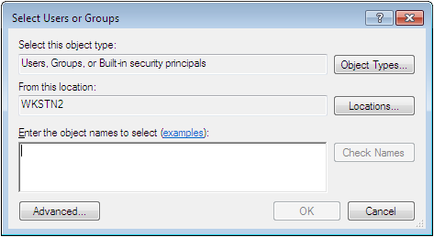
Assigning Standard NTFS Permissions
Notes:
Use the screens on the slide to explain how to assign NTFS permissions if you cannot demonstrate.

Slide 22
NTFS Standard Permissions – Full Control
Folder
File
Modify the folder permissions.
Take ownership of the folder.
Delete subfolders and files contained in the folder.
Perform all actions associated with all of the other NTFS folder permissions.
Modify the file permissions.
Take ownership of the file.
Perform all actions associated with all of the other NTFS file permissions.
Notes:
On the next several slides, explain what each Standard permission allows a Security Principal to do.

Slide 23
NTFS Standard Permissions – Modify
Folder
File
Delete the folder.
Perform all actions associated with the Write and the Read & Execute permissions.
Modify the file.
Delete the file.
Perform all actions associated with the Write and the Read & Execute permissions.

Slide 24
NTFS Standard Permissions – Read & Execute
Folder
File
Navigate through restricted folders to reach other files and folders.
Perform all actions associated with the Read and List Folder Contents permissions.
Perform all actions associated with the Read permission.
Run applications.

Slide 25
NTFS Standard Permissions – List Folder
Folder
File
View the names of the files and subfolders contained in the folder.
Not applicable

Slide 26
NTFS Standard Permissions – Read
Folder
File
See the files and subfolders contained in the folder.
View the ownership, permissions, and attributes of the folder.
Read the contents of the file.
View the ownership, permissions, and attributes of the file.

Slide 27
NTFS Standard Permissions – Write
Folder
File
Create new files and subfolders inside the folder.
Modify the folder attributes.
View the ownership and permissions of the folder.
Overwrite the file.
Modify the file attributes.
View the ownership and permissions of the file.

Slide 28
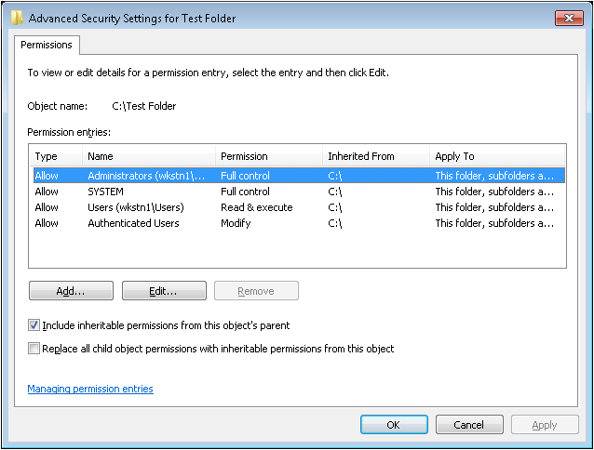
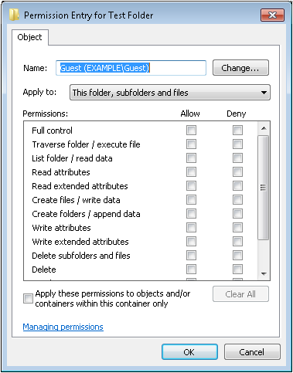
Assigning Special NTFS Permissions
Notes:
Use the screen shots on the slide to explain how to assign special NTFS permissions if you cannot demonstrate. Refer to the charts in the book for the exact meanings of the special permissions and explain that this task is less commonly done. Usually Standard permissions are used.

Slide 29
Resource Ownership
Every file and folder on an NTFS drive has an owner.
The owner always has the ability to modify the permissions, even if current permissions settings deny them access.
The owner is the person who created the file or folder.
Others with the “Take Ownership” permission can become the owner.
Notes:
Explain how the owner of the file always has access to the file/folder’s permissions so there is no way for a file or folder to become completely inaccessible, even if someone sets the permissions so that no one can access it.

Slide 30
Sharing Files and Folders
Notes:
Have a discussion about the purpose of Sharing Files and Folders to introduce the topic

Slide 31
Folder Sharing in Windows 7
Any folder sharing
Public folder sharing
Homegroup sharing
Notes:
Explain that Windows 7 provides addition methods for sharing files and folders and additional security mechanisms. Use the chart in the text book to help you describe the 3 different sharing features. Give examples of when you would use each one.

Slide 32
Sharing with Homegroups
Uses the Home network location to share the contents of libraries among all users
Automatically configured
Shares libraries in the users profiles
Can add libraries
Notes:
Describe how sharing with Homegroups works.

Slide 33
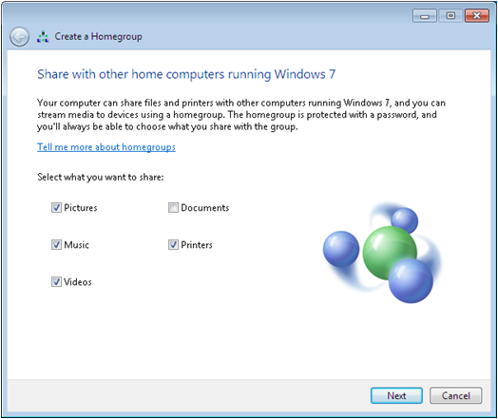
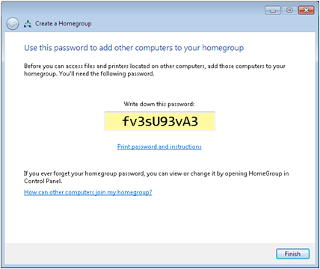
Creating a Homegroup
Notes:
Explain that when you select a Home network location, the computer attempts to find an existing homegroup. If one does not exist, the Create a Homegroup Wizard appears. If a Homegroup is detected, a Join the Homegroup Wizard appears.

Slide 34
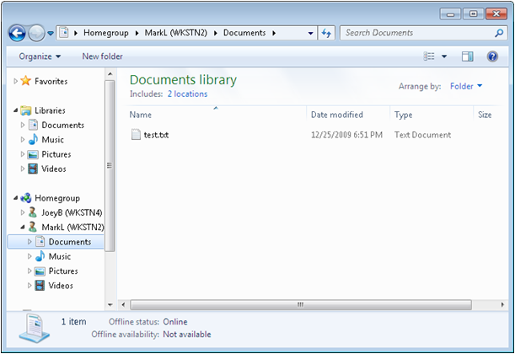
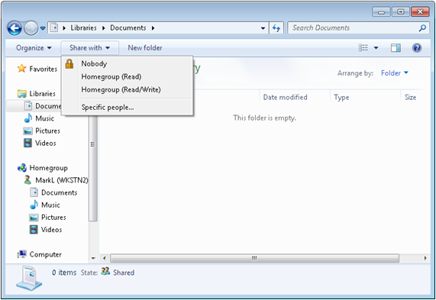
Working with Homegroups
Notes:
Explain how you can modified the homegroup users’ access for each library.

Slide 35
Sharing the Public Folder
Simplest way to give clients file sharing capability (small business networking)
Network Discovery and Public Folder Sharing must be turned on
Copy files to be shared to the Public folder
Notes:
Describe how easy it is for small businesses to share information using Public Folder Sharing.

Slide 36
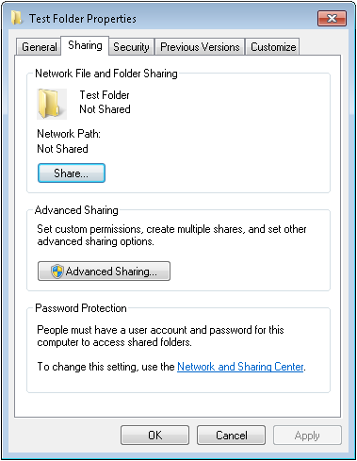
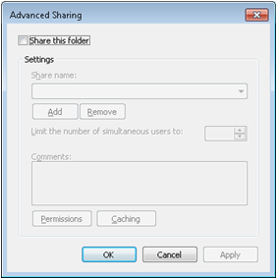
Any Folder Sharing
Full control over what material on the computer is shared
Which users have access and to what degree they have access
Notes:
Describe Any Folder Sharing and demonstrate or describe how to share a folder.

Slide 37
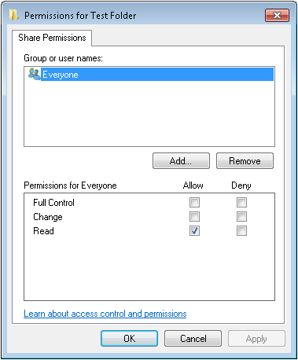
Managing Share Permissions
Share permissions are independent from other permissions.
With Password Protected Sharing enabled, users must have user accounts on the computer or in a domain.
Notes:
Using information from the textbook, review what each share permission allows a user to do. Outline the requirements for setting up shares and who can share folders.

Slide 38
Combining Share and NTFS Permissions
NTFS Volume
Shared
Folder
Share Permissions
FC
Users
NTFS Permissions
File A
On networks already possessing a well-planned system of NTFS permissions, share permissions are not really necessary. In this case, you can safely grant the Full Control share permission to Everyone, and allow the NTFS permissions to provide securiry.
R
NTFS Permissions
File B
FC
Notes:
These permissions only need to combine when a user is accessing a share on a computer, that happens to reside on an NTFS disk, with permissions defined. Note that share permissions and NTFS permissions are completely separate, and in order for a user to access a resource, they must be allowed by both types of permissions.

Slide 39
Working with Printers
Notes:
Briefly introduce Windows Printing. We will discuss in detail in the upcoming slides.

Slide 40
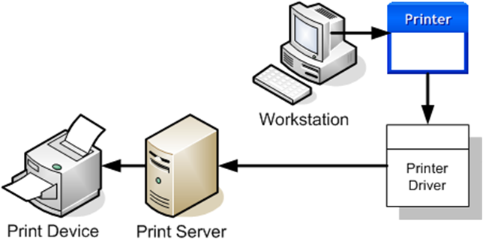
Windows Print Architecture
Printer - the software interface through which a computer
communicates with a print device
Printer Driver - a device driver that converts the print jobs generated by applications into an appropriate string of commands for a specific print device
Printer Server - a computer (or stand-alone device) that receives print jobs from clients and sends them to print devices that are either locally attached or connected to the network
Print Device - the actual hardware that produces hard copy documents on paper or other print media
Notes:
Describe each of the 4 print components. Explain how printing works.

Slide 41
Windows Printing Flexibility
Stand-alone local printing
Printer shared on the network
Print device connected directly to LAN
Create a printer pool (one print server with more than one print device)
Connect multiple printer servers to a single print device
Notes:
Describe the different ways printing can be configured on a Windows network and when each one might be used.

Slide 42
Adding a Local Printer
Most common configuration for home, small business, or workgroups
Local users can print their own jobs
Can share the printer with other network users

Slide 43
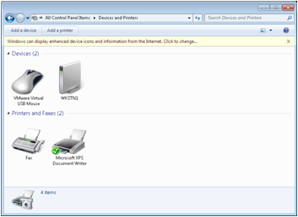
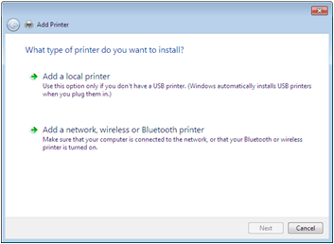
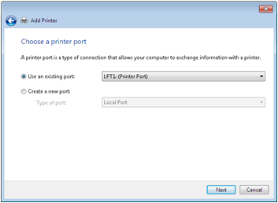
Add a Local Printer 1
Notes:
If you are unable to demonstrate, use the screen shots to describe the process of adding a local printer. The next slide continues the process.

Slide 44
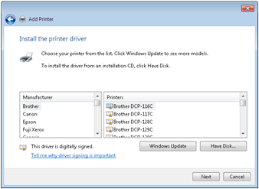
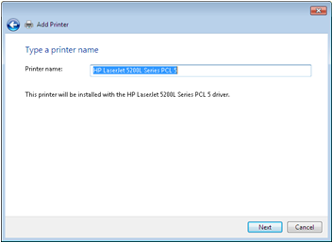
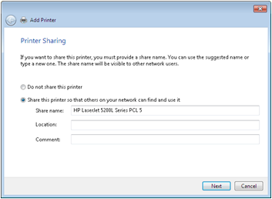
Add a Local Printer 2

Slide 45
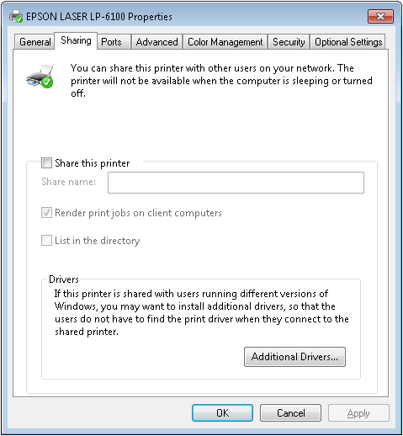
Sharing a Printer
Notes:
Explain that Windows 7 computers can act as a print server by sharing printers so they can be used by other network users. Discuss whether this is a good idea in a larger network environment and what you might need to do for a large network to work better. Reinforce that Network Discover and File and Printer sharing must be turned on in order to share a printer. Discuss the different elements on the screen shot on the slide.

Slide 46
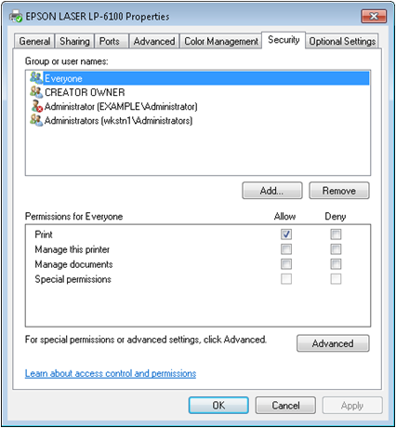
Configuring Printer Security
When password protected sharing is turned on, users must log on to the computer with a user account that has a password.
Users must have the appropriate permissions to access the printer.
Notes:
Explain the different elements on the printer properties Security tab.

Slide 47
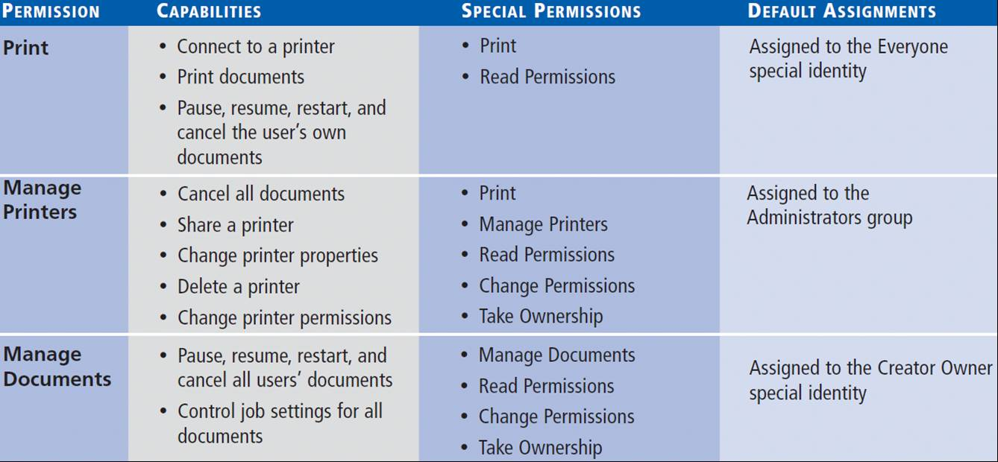
Printer Permissions
Notes:
Describe printer permissions

Slide 48
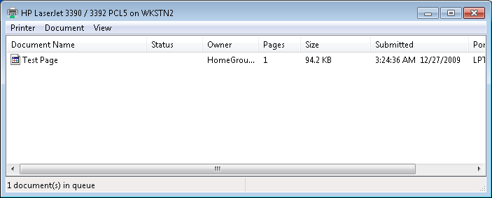
Managing Documents
Pausing, resuming, restarting, and canceling documents in the print queue
Notes:
, all printers assign the Allow Print permission to the Everyone special identity, which enables all users to access the printer and manage their own documents. Users that possess the Allow Manage Documents permission can manage any users’ documents. To manage documents, you open the print queue window for the printer.
Explain how you access the menus to perform the tasks.

Slide 49
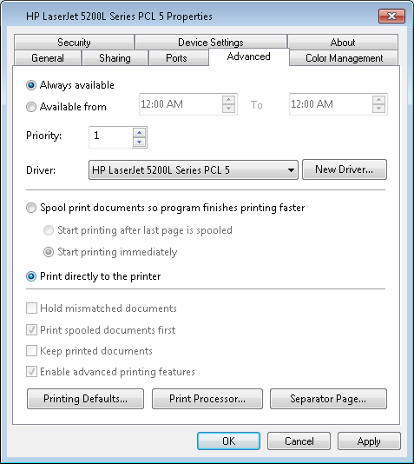
Managing Printers
Printer priority
Scheduling printer access
Creating a Printer Pool
Notes:
Users with the Allow Manage Printers permission can go beyond just manipulating queued documents and reconfigure the printer itself. Managing a printer refers to altering the operational parameters that affect all users and controlling access to the printer.
Describe each management task.

Slide 50
Skills Summary
Windows 7 has several sets of permissions, which operate independently of each other, including NTFS permissions, share permissions, registry permissions, and Active Directory permissions.
NTFS permissions enable you to control access to files and folders by specifying just what tasks individual users can perform on them.
Share permissions provide rudimentary access control for all of the files on a network share.
Notes:
Review the Skill Summary to wrap up your lesson.

Slide 51
Skills Summary (cont.)
The printing architecture in Windows is modular, consisting of the print device, a printer, a print server, and a printer driver.
A local printer is one that supports a print device directly attached to the computer or attached to the network.
A network printer connects to a shared printer hosted by another computer.

